Slide 1

Electric Vehicle Infrastructure Locator
By:
Lori Pepper

Slide 2
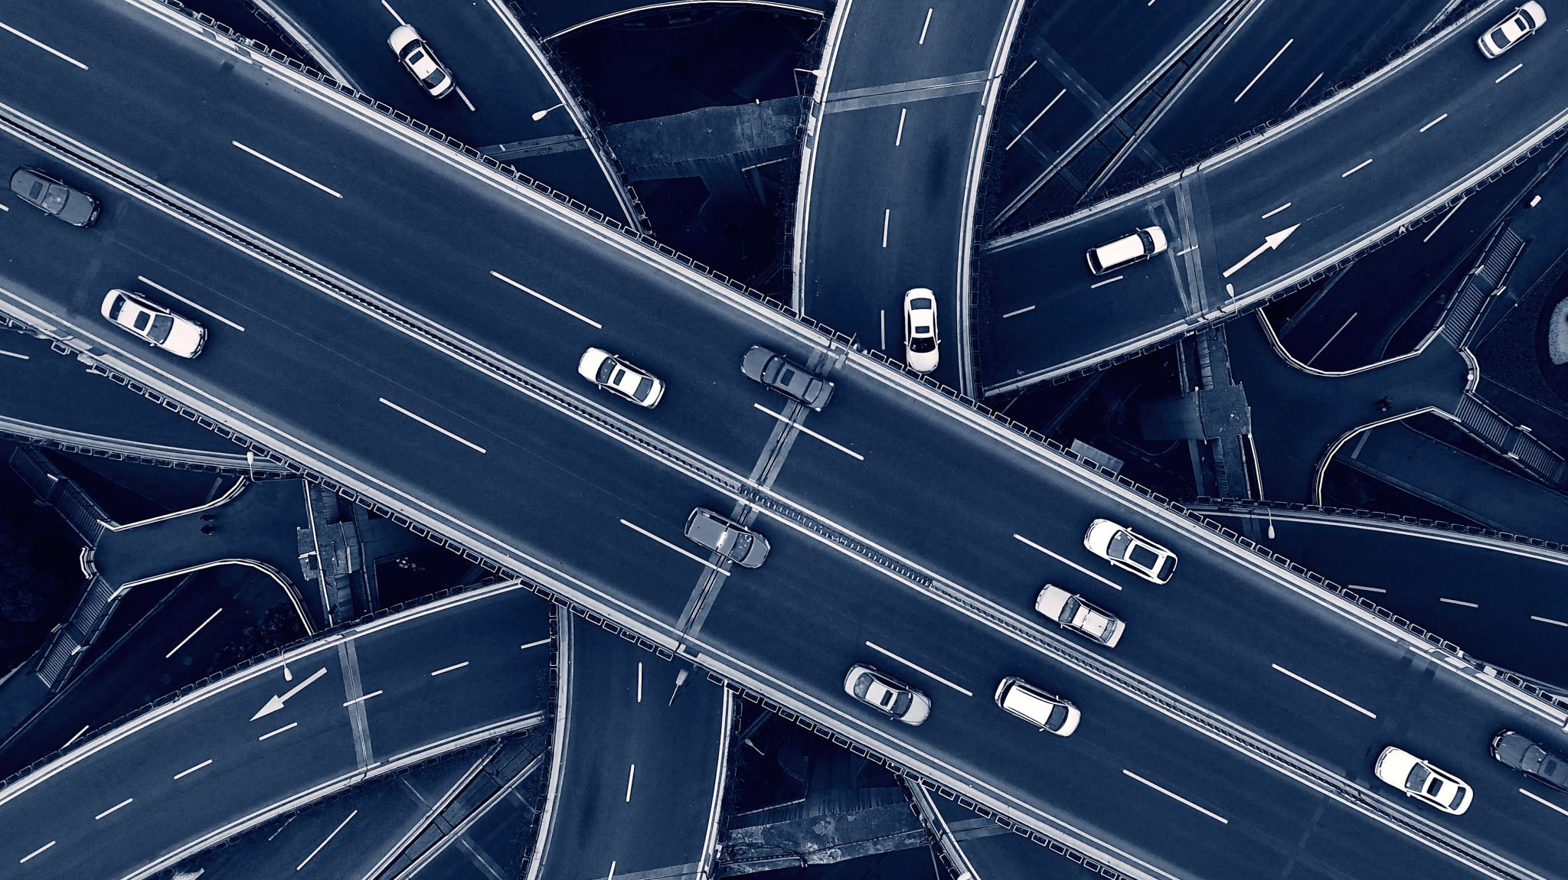
Purpose – to create an easy to use locator for those who have a ZEV or are considering purchasing a ZEV
The transportation sector emits about 40% of the greenhouse gases in our atmosphere – leading to record drought, extended and more intense wildfire seasons, and increased coastal erosion.
In response, Governor Newsom has created a series of policies designed to encourage adoption of zero-emission vehicles by fleets and individuals. These vehicles include technologies such as battery-powered vehicles and hydrogen fuel cell-powered vehicles.
One of the primary barriers to adoption is the lack of widespread access to charging and fueling stations.
As the government and private industry continue to build out an infrastructure network, the public should have easy access to where battery charging stations and hydrogen fueling stations are to support trip planning. Understanding these locations can also support a person’s decision as to whether or not owning a ZEV would work for their life.

Slide 3

Data collection
The California Energy Commission regularly updates its datasets for ZEV infrastructure and makes them publicly available on their website.

Slide 4

Data Cleaning & Conversion
Ensured the appropriate data points:
Lat/Lng
County
Technology
Retail Status
Converted the data to a JSON dictionary

Slide 5

Battery Charging Stations

Slide 6
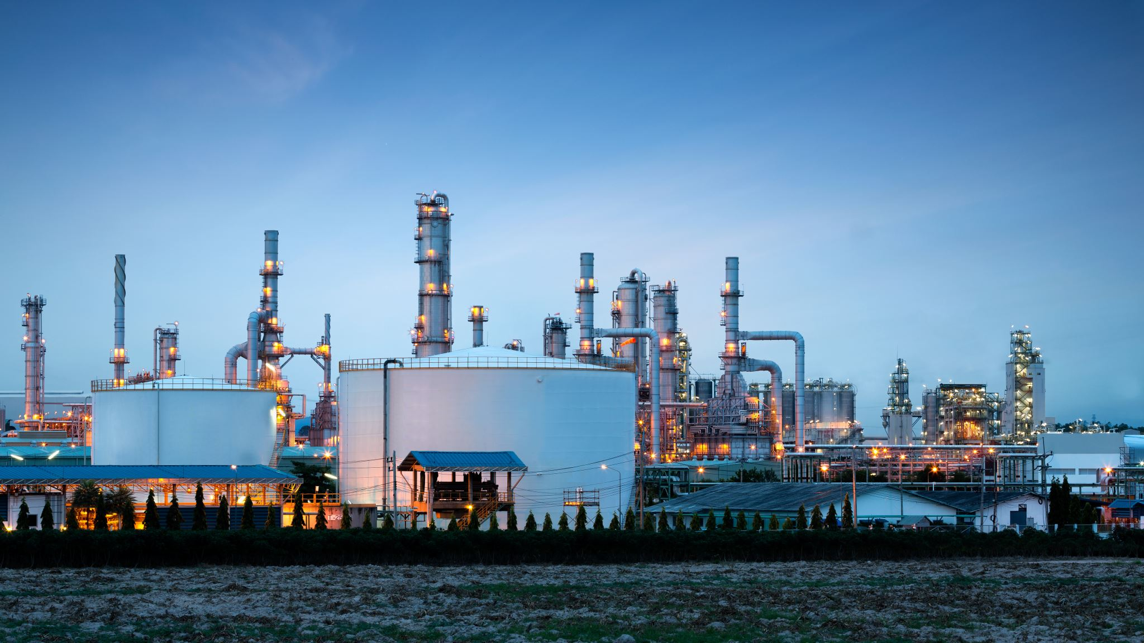
Hydrogen Fueling Stations

Slide 7
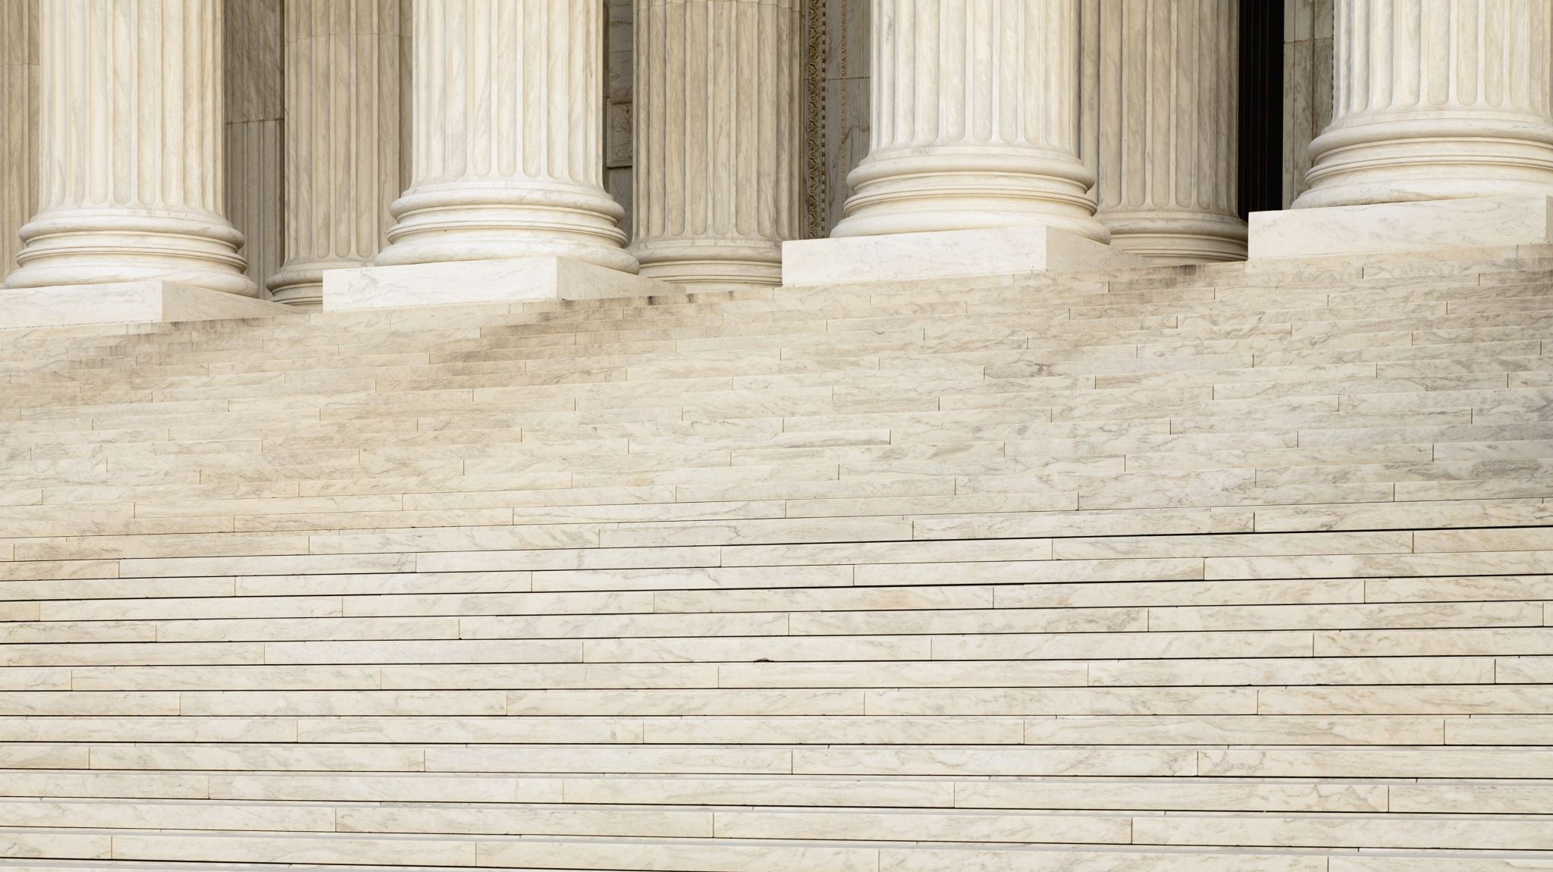
Stacked Bar Chart

Slide 8

Radial Bar Chart ApexCharts

Slide 9
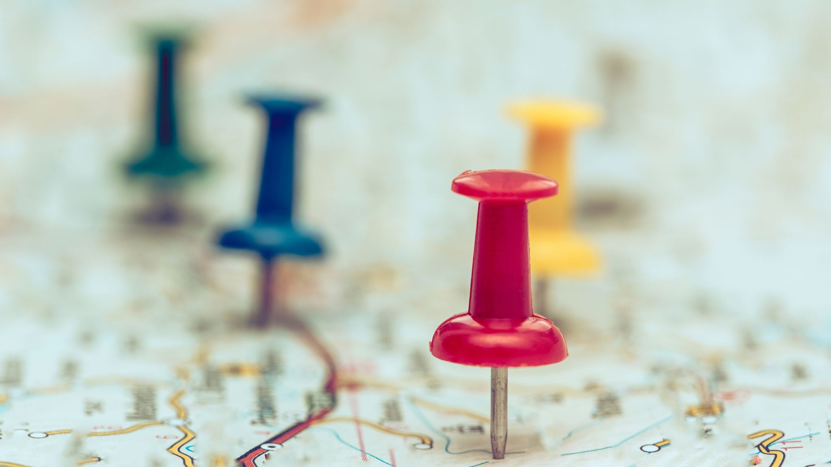
Location Map

Slide 10

ANY QUESTIONS?

Slide 11

THANK YOU

